Slide 1
Collaborative Filtering
Mustafa Cavdar
Neslihan Bulut
Notes:
An algorithmic framework for performing collaborative filtering.

Slide 2
Outline
Definition
Problem Space
Neighborhood based methods
Experiments
Weighting Possible Neighbors
Selecting Neighborhoods
Producing a Prediction
Conclusions
Future Work

Slide 3
Automated Collaborative Filtering
Reduce information load
Complements Content-based information filtering systems
Collaborative filtering utilizes human judgments(ratings)
Key advancements over content based filtering:
Support for contents not easily analyzed by automated processes
Filter items based on quality and taste
Ability to provide serendipitous recommendations
Notes:
Automated collaborative filtering is a popular technique used for reducing information overload and it’s often used to complement content-based information filtering systems.
Content based information filtering technique have proven to be effective at locating textual documents relevant to a topic
In collaborative filtering human judgements for items in a given domain are collected and it builds matching between people who share the same information needs or the same tastes.
In collaborative filtering, humans provide feedback by declaring relevance, quality and interest of items. This provides superiority for analyzing movies, ideas, feelings, people etc. Analyzing quality and taste dimensions are easier for human beings.
Also collaborative filtering can bring items that aren’t exactly what the user was expecting but would be valuable for them. Especially in the movie domain this aspect is used very frequently.
Collaborative filtering isn’t well suited for detecting information for a specific content. In this paper an algorithmic framework for performing collaborative filtering is represented.

Slide 4
Problem Space
Predict how well a user will like an item
History of preference judgments for a community of users
Prediction engine
Matrix of users and ratings
Predict the values for specific empty cells
Neighborhood based methods are most prevalent
Other methods; Bayesian networks, singular value decomposition with neural net classification and induction rule learning
Notes:
Preference judgments can be explicit statements or implicit data from which judgments could be inferred from.
In neighborhood based methods a subset of appropriate users are chosen based on their similarity to the active user, and a weighted aggregate of their ratings is used to generate predictions for the user.
In the paper neighborhood-based methods are explored and they claim to present new better performing algorithms

Slide 5
Neighborhood based methods
Neighborhood based methods has 3 basic steps;
Weight all users with respect to similarity with the active user
Select a subset of users to use as a set of predictors
Normalize ratings and compute a prediction from a weighted combination of selected neighbors’ ratings
One of the first introduced neighborhood based automated collaboration filtering algorithm;
Pearson correlation to weight user similarity;
$w_{a,u}= \frac{\sum_{i=1}^{m}{\left(r_{a,i} −\overline{r_{a}}\right)∗(r_{u,i}−\overline{r_{u}})}}{σ_{a}−σ_{u}}$
Use all available correlated neighbors
Compute a final prediction: weighted average of deviations from the neighbor’s mean:
$p_{a,i}= \overline{r_{a}}+\frac{\sum_{u=1}^{n}{\left(r_{u,i} −\overline{r_{u}}\right)∗ w_{a,u}}}{\sum_{u=1}^{n}{w_{a,u}}}$
Notes:
$p_{a,i}$ represents the prediction for the active user a for an item i. n is the number of neighbors and $w_{a,u}$ is the similarity weight between the active user and neighbor u as defined in the pearson correlation coefficient.
Along with pearson correlation, cosine vector similarity was also used and the correlations seem to be better with the cosine vector similarity.

Slide 6
Experimental Technique
Compare results of different neighborhood based prediction algorithms
Data: anonymous reviews from the MovieLens movie recommendation site
122,176 ratings from 1173 users, every user having at least 20 ratings.
%10 users selected to be test users, ratings for 5 items were withheld
For each item getting predicted highest ranking neighbors that have rated the item are used for the prediction
Quality of a prediction algorithm;
Coverage: Usually high
Accuracy: Statistical accuracy or decision support accuracy
Notes:
A user may have a different neighborhood for each item. Quality of a prediction can be measured by comparing the predicted values for the withheld items to the actual values.
Quality of a prediction algorithm can be measured on a couple dimensions; coverage, and accuracy. Coverage is the measure of the percentage of items for which a recommendation system can provide predictions. A basic coverage metric is the percentage of items for which prediction is available. Usually for the experiments coverage is high unless an item has ratings from very few people and those doesn’t have any correlation with the active user or there isn’t any rating for an item.
To assess the accuracy of a prediction algorithm statistical accuracy metrics or decision support accuracy metrics can be used. Statistical accuracy metrics compare the prediction with the actual rating value. Mean Absolute Error and root mean squared error are techniques that have been used to assess the statistical accuracy, for this paper they report mean absolute error.
Decision support accuracy metrics evaluate how effectively predictions help a user select high quality items. In this perspective a prediction value between 1.5 and 2.5 wouldn’t make a difference if the user only chooses to see a movie with a prediction of 4 or above. For the decision support accuracy in the paper ROC sensitivity is used. ROC sensitivity declares the diagnostic power of a filtering system. To assess the ROC sensitivity user’s own ratings were used to assign good or bad labels to items.

Slide 7
Experimental Technique
Conclusions from empirical analysis of prediction algorithm components are tested
Components:
Similarity weight
Significance weighting
Variance weighting
Selecting neighborhoods
Rating normalization
Variations of the components’ techniques were evaluated
Notes:
All components except the one being tested was held constant so that the results reflect the differences in the component being tested. Variations of a component were tested on the best performing algorithm.

Slide 8
Weighting Possible Neighbors
Similarity weighting
Pearson Correlation Coefficient: Measures the degree to which a linear relationship exists between two variables.
Spearman Rank Correlation Coefficient: Similar to Pearson but doesn’t rely on model assumptions, and performs similarly as well.
Vector Similarity: performs well for information retrieval but not as good for collaborative filtering
Entropy: Not as good as pearson correlation
Mean-squared difference: Not as good as pearson correlation
Notes:
The first step in neighborhood based prediction algorithms is to weight all users wrt similarity with the active user. Several different similarity measures have been used, the most common one is the pearson correlation coefficient. Pearson correlation has a set of assumptions regarding data; namely that the relationship must be linear, errors must be independent and have a probability distribution with mean 0 and constant variance for every setting of the independent variable. When these assumptions aren’t satisfied, pearson correlation becomes a much less accurate indicator of similarity.

Slide 9
Weighting Possible Neighbors
Significance Weighting:
Considers ‘trust’ in correlation with neighbor
Neighbors with tiny samples are terrible candidates
Similar results with Pearson correlation

Slide 10
Weighting Possible Neighbors
Variance Weighting:
Ratings on some items are more valuable
Increases the influence of item with higher variance

Slide 11
Weighting Possible Neighbors
Variance Weighting (Cont.):
Ratings on some items are more valuable
Increases the influence of item with higher variance

Slide 12
Weighting Possible Neighbors
Variance Weighting (Cont.):
No significant effect on accuracy of the prediction algorithm
Ignores disagreements with popular feeling

Slide 13
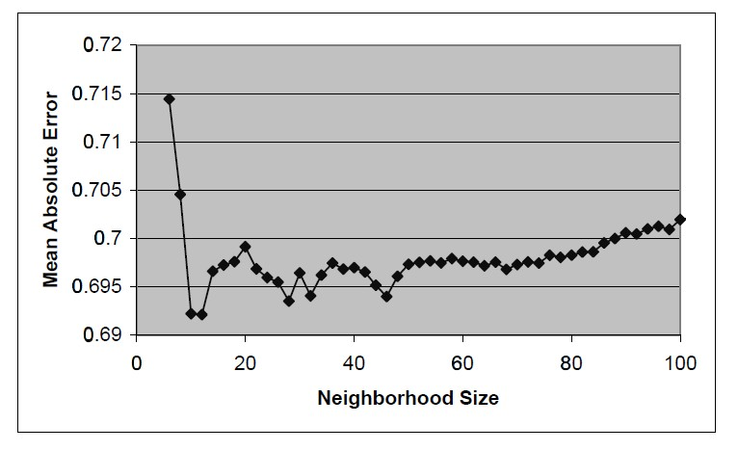
Selecting Neighborhoods
Select a subset of users

Slide 14
Selecting Neighborhoods
Correlation-thresholding
Set an absolute correlation threshold
Pick anyone whose correlation is greater
High threshold => Results in small neighborhood
Low threshold => nullify purpose of thresholding

Slide 15
Selecting Neighborhoods
Best-n-neighbors
Pick best n correlates
Large n => too much noise
Small n => poor predictions

Slide 16
Producing a Prediction
Combine ratings of neighbors
Deviation-from-mean approach

Slide 17
Conclusions
Filtering information based on quality and taste
Best-n-neighbors is the best
Non-personalized average algorithm found

Slide 18
Future Work
Apply the framework diverse set of domains
Integration with existing retrieval technology
Scale algorithms to handle extremely large datasets

Slide 19
THANK YOU!

